Slide 1
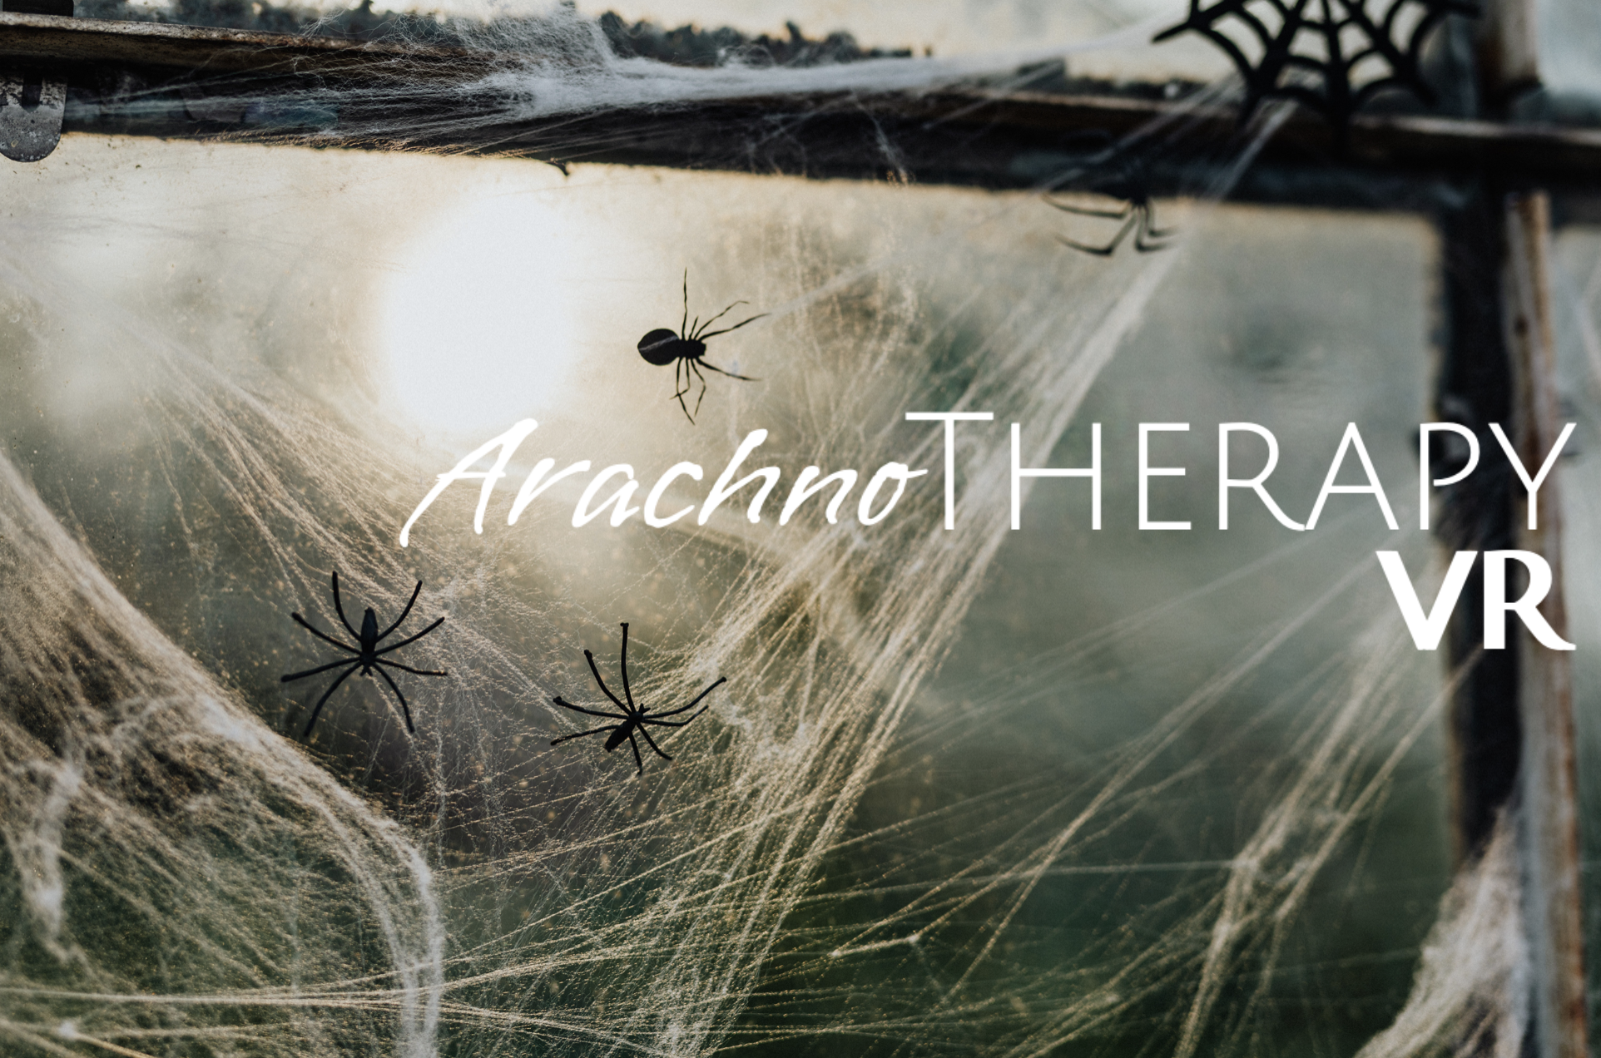
Notes:
Welcome everyone to our capstone presentation for our project titled ArachnoTherapy VR.

Slide 2
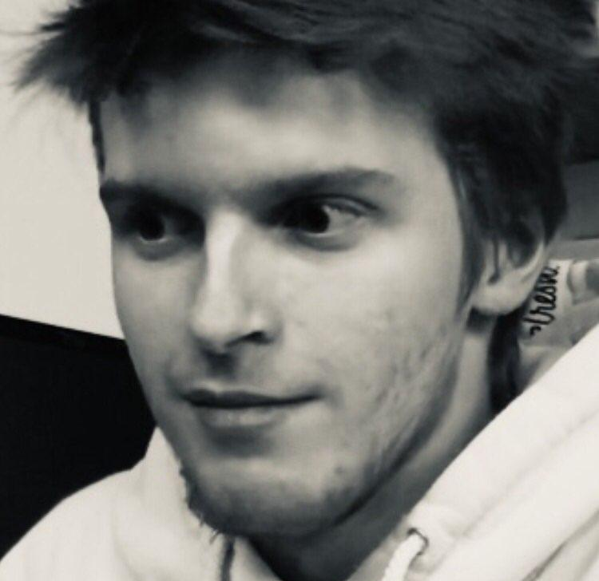
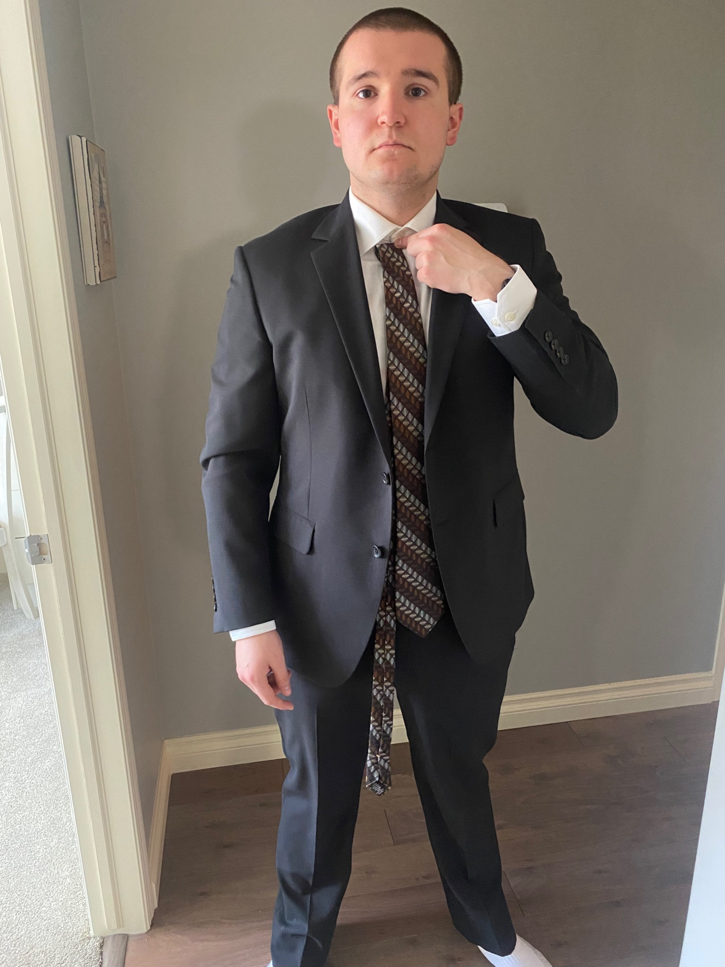
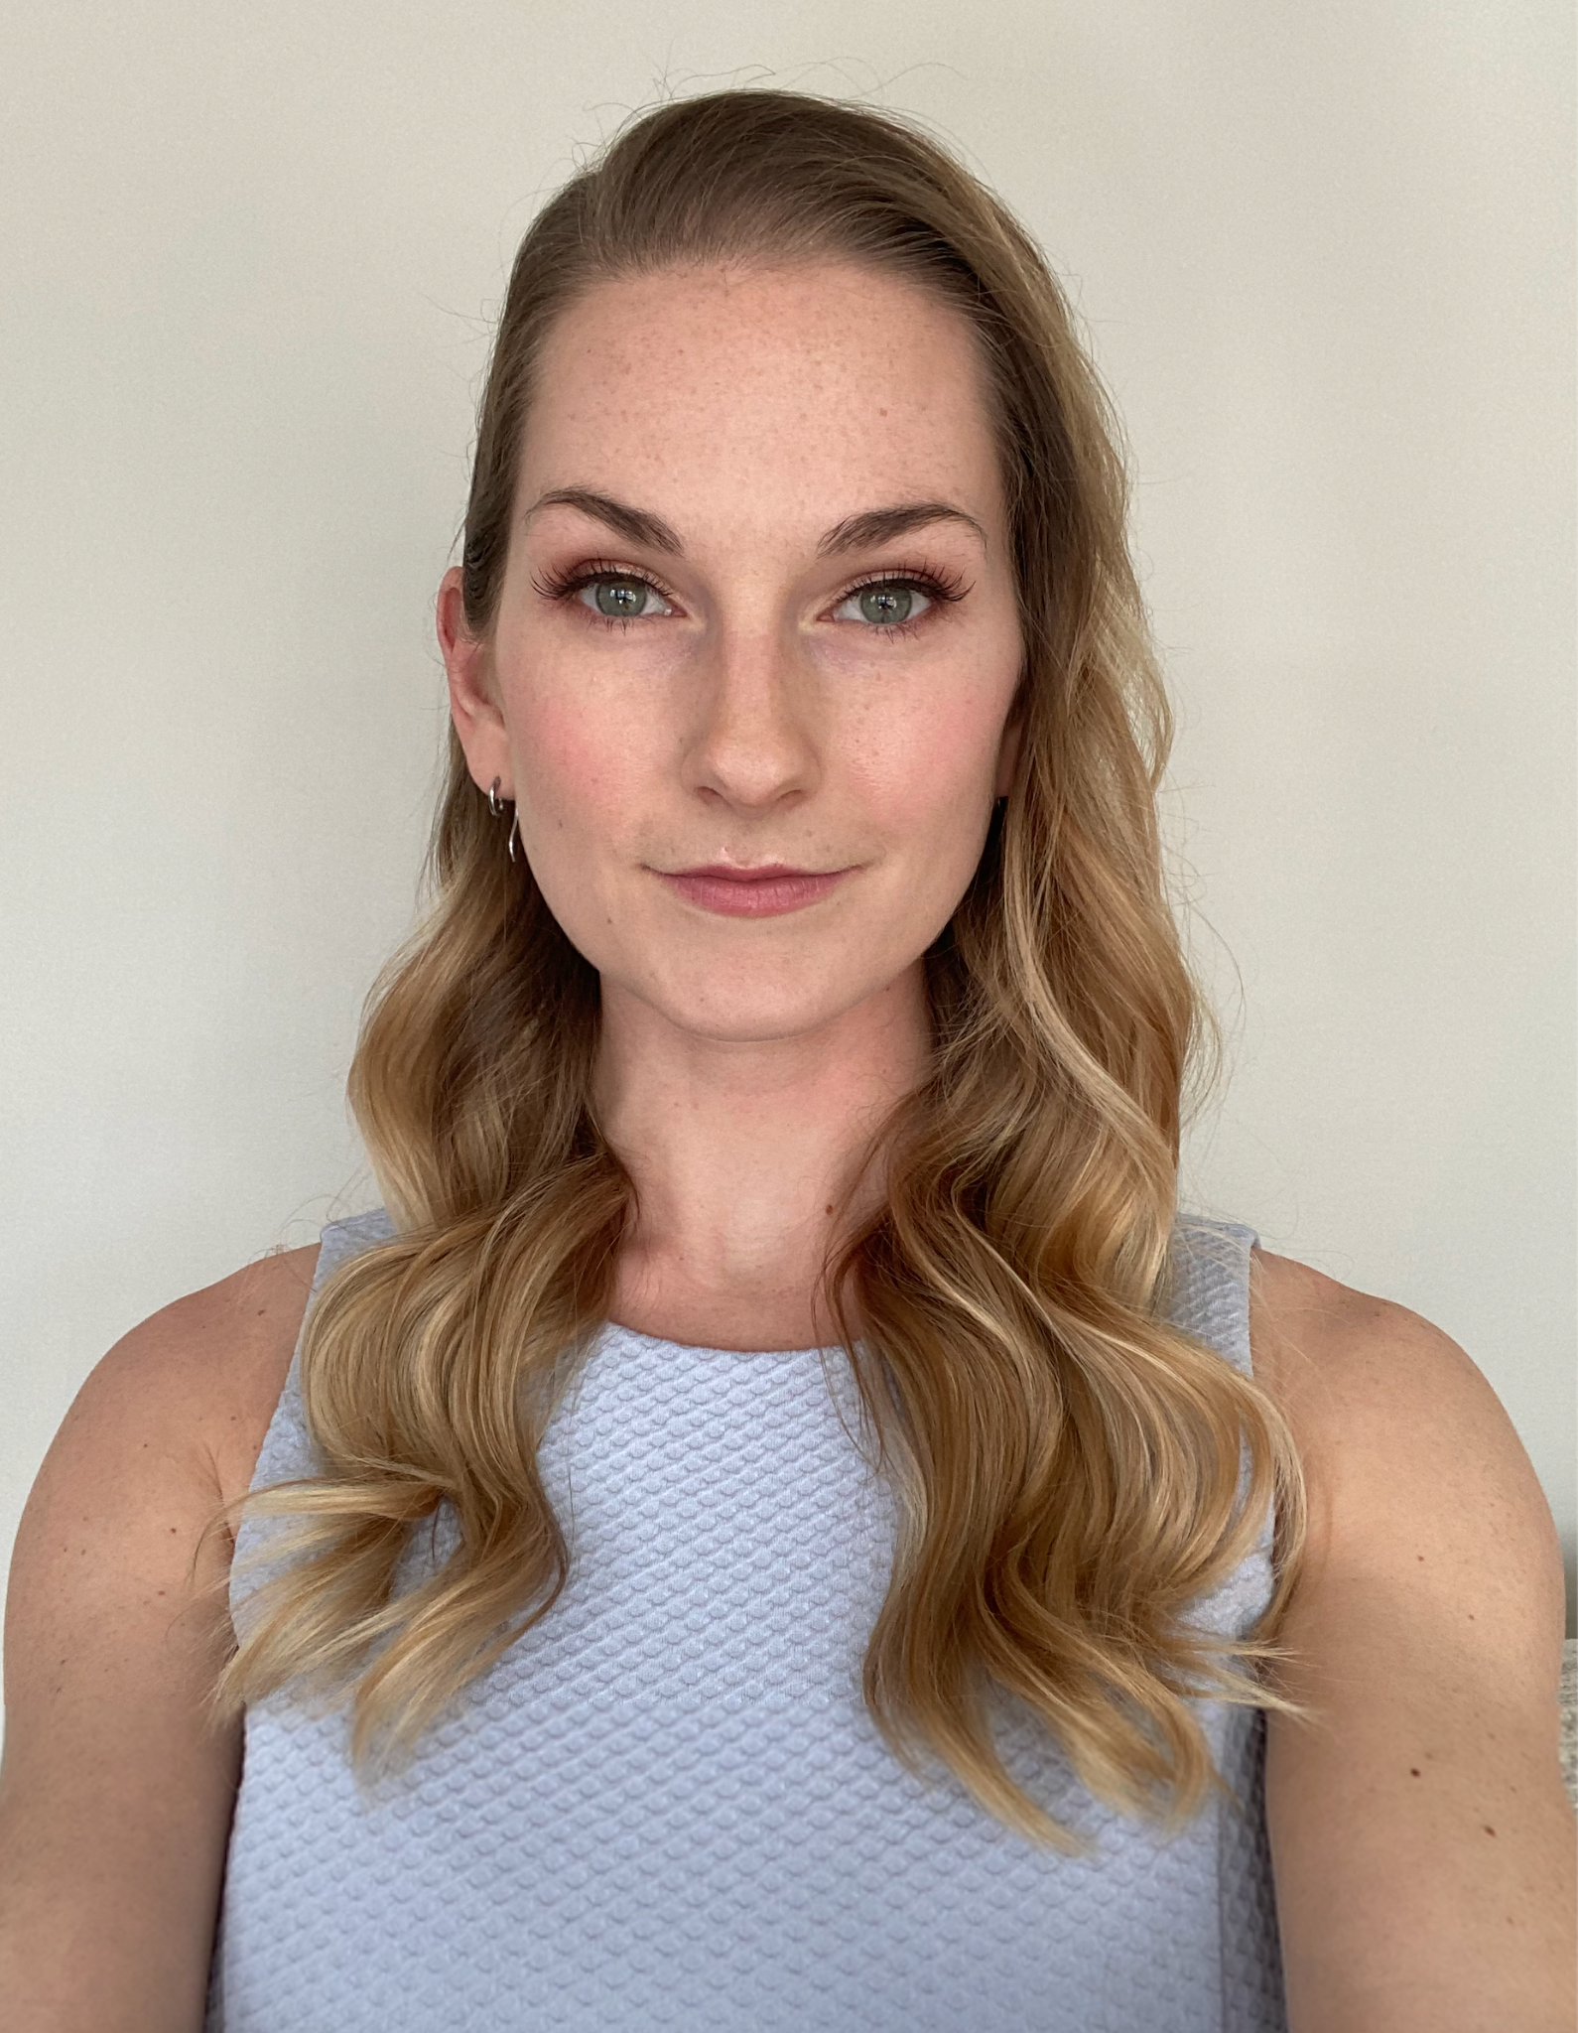
Jacob Chapman
Business Lead
Jacob Sauer
Lead Developer
Roxanne Harrison
Scrum Master / Design Lead
Notes:
My name is Roxanne Harrison - I was the Scrum Master and Design Lead for the project. I’m joined by Jacob Sauer - our lead developer as well as Jacob Chapman - our business lead.

Slide 3
Commercial
Notes:
To give you an introduction to our project and what it’s all about we’ll first show you our commercial.

Slide 4
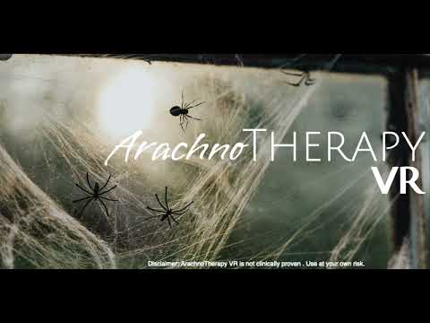

Slide 5
Problem
Unpredictability in the real world
Current Virtual Reality Exposure Therapy is passive
In-person therapy is not accessible to everyone
Notes:
Roxanne: So - what is it that we’re trying to solve. One of the main problems with current exposure therapy techniques, especially for arachnophobia is the danger with unpredictability of spider behaviour. Virtual reality exposure therapy is one step safer, however interactions the user has are often only passive. These things, coupled with the increasing demand and shortage of therapists available make exposure therapy less accessible than necessary.

Slide 6
Our Why
“Improve accessibility and efficacy of current exposure therapy techniques by allowing for level-based progression and guidance from a virtual therapist.”
Notes:
Roxanne: We plan to solve these problems by creating an application to improve accessibility and efficacy of current exposure therapy techniques by allowing for level-based progression and guidance from a virtual therapist

Slide 7
Solution
Series of virtual rooms
Increasing intensity
User in control
Notes:
Roxanne : By creating a series of virtual rooms we’re able to facilitate a linear progression with increasing intensity that’s completely in control of the user. As the user moves from room to room they’re guided by the virtual therapist on what to expect, what to do next, and how to cope with the stimuli they experience.

Slide 8

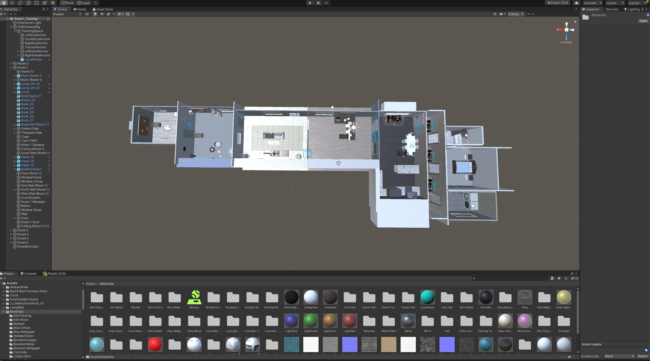
Technology Used
Familiar
Code design
Oculus compatible
Notes:
We chose Unity as the game development engine for three main reasons - one being the team’s familiarity with the platform. Two - with the scripting language for Unity being C# we were also able to showcase our knowledge of software design principles learned from previous classes. And finally, Unity also enabled application development for the Oculus headsets provided by the University’s VR lab - graciously loaned to us for the duration of our project. Here you see the overview of our digitally created scene.

Slide 9
Design Process
Room design
Room code additions
Testing
Repeat
Notes:
In order to design that scene we followed an iterative process. First we created the room design, including the objects like chairs and walls, added materials to make things look realistic like wood floors or paint. Then in step two we added code to make things interactive like being able to pick up books or press buttons. Step 3 we tested all interactions and made sure there were no design flaws, then repeated with the next room.

Slide 10

Empty Scene
Notes:
We started out with an empty scene in Unity.

Slide 11
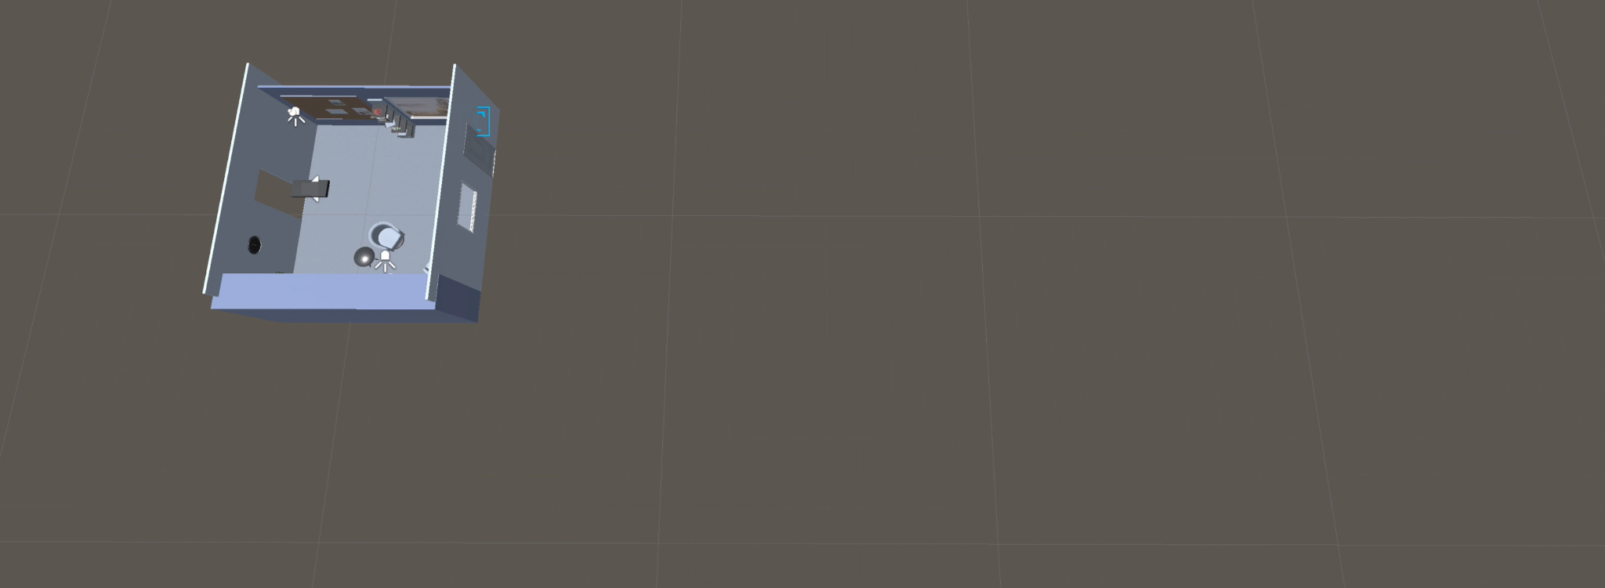
Room 1 - Therapist’s Office
Notes:
Created the therapist’s office first.

Slide 12
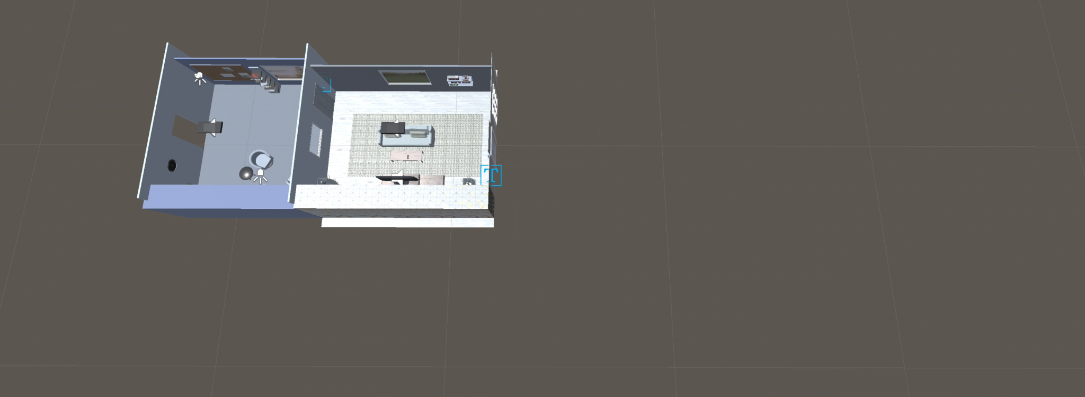
Room 2 - Livingroom
Notes:
Added the livingroom next.

Slide 13
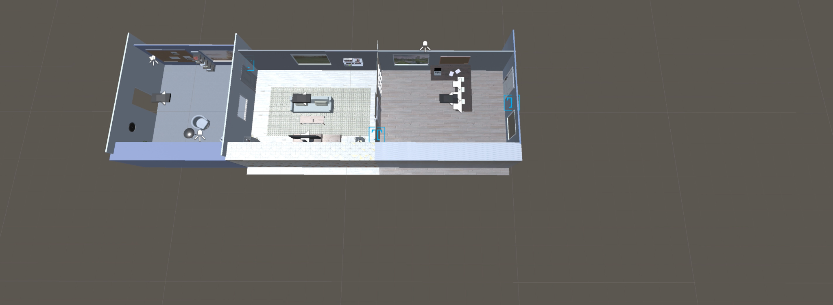
Room 3 - Office
Notes:
Then the office.

Slide 14
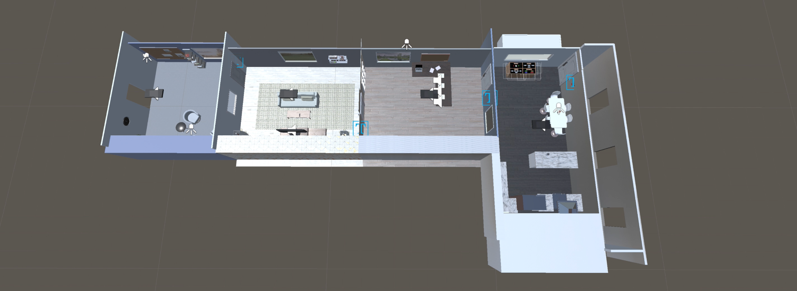
Room 4 - Kitchen
Notes:
Then the kitchen, terrarium for users to first get used to the spider creation panel .. then added the hallway safe zone.

Slide 15
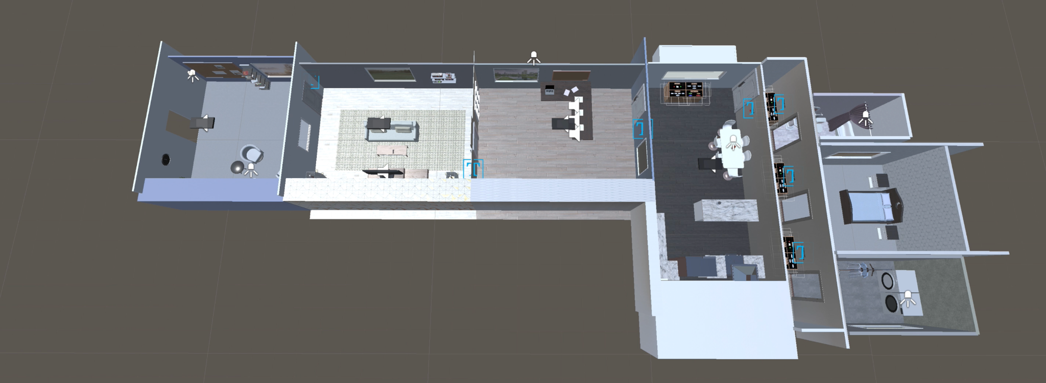
Room 5 - Bathroom / Bedroom / Laundry Room
Notes:
Three variations of room 5 were then added where the spiders crawl around the rooms themselves, the bathroom, bedroom, and laundry room.

Slide 16
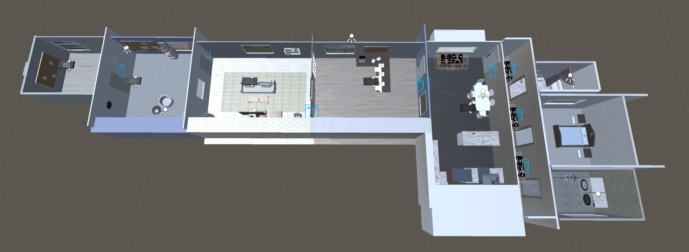
Room 0 - Introduction / Tutorial
Notes:
And finally after our first round of user testing we determined it would be beneficial to include an introductory or tutorial room where users would first learn about the controls and the types of interactions they could expect before starting the therapy session in an anxious headspace. Next, Chapman is going to tell you about the room breakdowns in more detail.

Slide 17
Room Breakdown
Safety features
Required interactions
Preview for upcoming room
Notes:
Thanks Roxanne,
With respect to each room, we focused on 3 major parts which are safety features, required interactions, and previews for upcoming rooms. We want to ensure that users are safe and in control of their actions inside the experience.

Slide 18
Room 0
Notes:
Room 0 is the tutorial room the user starts in when first entering the experience. This is where they’ll receive instructions from the omniscient therapist to guide them through the interactions for the room.

Slide 19
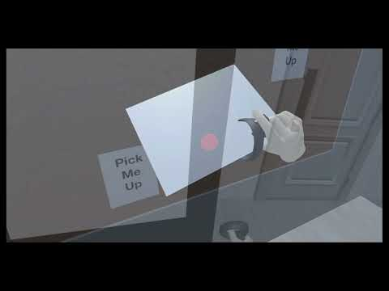
Notes:
As you heard there, the therapist gives the user directions on how to interact with objects and where to go next. The user can read about the controls, practicing picking up objects that are highlighted, and learn coping techniques to use throughout the session. When they’re ready to move into the therapy session the button by the door will explain what to expect in the next room.

Slide 20
Room 1
Notes:
Room 1 is the start of exposure therapy, where the user is introduced to many pamphlets on the wall, to get them acquainted with facts about spiders, as well as some myths that may be heard.

Slide 21
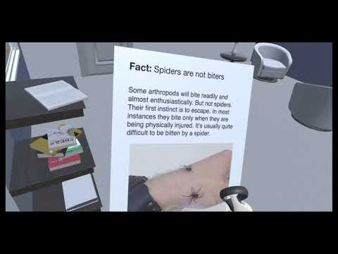
Notes:
As you can see, the user is able to pick up and read each pamphlet at their own pace. These are highlighted in pink, meaning they must be picked up in order to advance to the next room. When all objects highlighted in pink are interacted with, and the button on the wall is pressed, the window to the next room will be visible, and the user will be able to see what is next.

Slide 22
Room 2
Notes:
Room 2 is the next level of exposure therapy within a living room setting, it exposes the user to a television screen where they can watch videos of spiders.

Slide 23
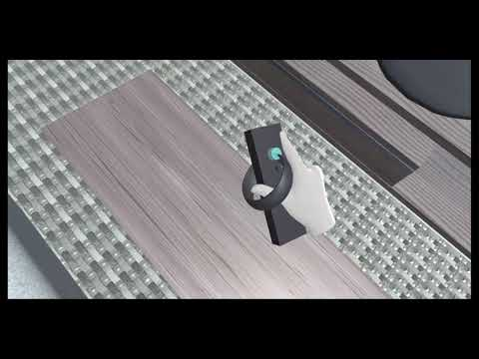
Notes:
When the user enters room 2, they must turn on the TV by interacting with the remote on the table. The user can then watch spiders shown on the screen until they are comfortable moving on to the next room by pressing the button on the wall.

Slide 24
Room 3
Notes:
Room 3 showcases the user clay models of different types of spiders, as well as providing educational content about them.

Slide 25
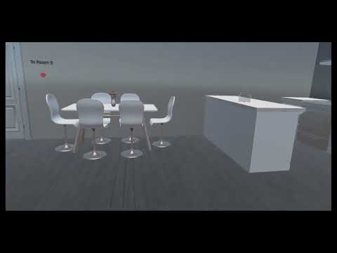
Notes:
Upon entering room 3, the user finds themself looking at 3 clay models of spiders which will be later seen in rooms 4 and 5. This rooms purpose is to educate the user on the specific spiders, by having audio clips and pamphlets that the user can focus their attention on. The user can pick up each spider to get a feel of what they can expect in the upcoming rooms. I will now pass it off to Sauer who will talk about rooms 4 and 5

Slide 26
Room 4
Notes:
Thank you, Chapumano. In Room 4, the user comes face-to-face with “living” spiders for the very first time. They can watch a spider crawl around inside of a jar on the kitchen table, and become introduced to a spider creation interface that places spiders in an enclosed terrarium.

Slide 27
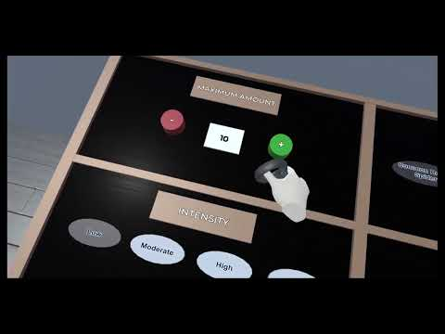
Notes:
As you can see, the jar on the counter contains the first live spider in ArachnoTherapy VR. One of the objectives in this room is to stand close to the jar and observe the spider as it moves around. On the other side of the room, the user can manipulate various parameters on the spider creation interface, including the maximum amount that can be present in the terrarium at one time, the diversity (which corresponds to species), and the intensity (which dictates the movement speed, possible actions, and frequency at which a new action is chosen). Finally, the control panel on the bottom right allows the user to add one spider, add all remaining spiders, remove one spider randomly, or remove all spiders.

Slide 28
Room 5
Notes:
Finally, Room 5 is the climax of our application. Within Room 5, the user can use the same spider creation interface to create free-roaming spiders in three different settings, and enter these settings to interact with the spiders in as “hands-on” of a manner as the Oculus Quest can provide.

Slide 29
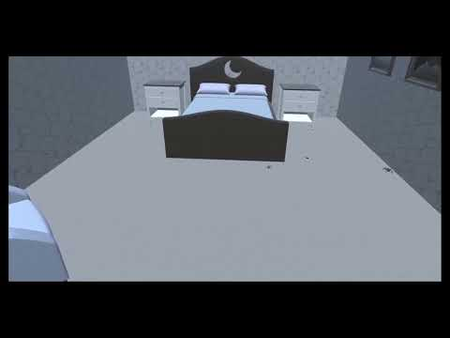
Notes:
Our psychology consultant emphasized that context is everything when it comes to specific phobias, so we built three different settings for Room 5 - a bathroom, a bedroom, and a laundry room. The user can create and observe spiders in any or all of these settings. There are no specific objectives in this room, so the user can stay for as little or as long as they want. If they ever become overwhelmed at the quantity or intensity of the spiders in a given room, they can return to the hallway that leads into all three rooms, as it is not possible for the spiders to enter the hallway. Once the user is finished in Room 5, they can push a large red button on the back wall of the hallway to end the experience.

Slide 30
Psychology Influence
Balance good software development principles with good psychiatric design principles
Dr. Nick Carleton as key stakeholder
Psychology textbooks
Notes:
While the backend of ArachnoTherapy VR was very much rooted in software development principles, the design choices for the frontend were predominantly dictated by the psychological principles behind good exposure therapy. As such, it was essential for us to consult with experts in psychology to ensure that an equilibrium between these sets of principles could be established. Dr. Nick Carleton, a decorated psychology professor here at the University of Regina, served as a key stakeholder and consultant for us throughout our six-month development cycle. His insight assisted us in designing the therapist character, educational modules, and the overall setting, as did the various psychology textbooks that he recommended for us to read.

Slide 31
Project Hiccups
Spider behaviour glitches
The dreaded jar
Notes:
Of course, our project was not without hiccups and infuriatingly humorous setbacks. For example, there were plenty of behavioural glitches with the spiders in the early phases of the project. Sometimes the spiders would collide with one another and careen backwards at unrealistically high speeds, generate vertical momentum and climb high into the air, or somehow bypass the invisible barriers of the Room 5 settings and enter the hallway - which was always supposed to be a spider-free safe zone. Finally, you may be wondering why the jar in Room 4 is immovable. We always intended for this jar to be a mandatory grabbable object, but we found that, no matter what we did, the spider would almost always fall out of the jar when it was picked up. So, this obviously needed to be changed.

Slide 32
Future
Live therapist intervention
Therapy VR Series
Clinical trial
Notes:
As for this project’s future prospects, we see three possible areas of expansion. First, we could add logic for a therapist to intervene in-person while a patient is immersed in the experience, and potentially even act as an external safeguard if their patient were on the verge of a panic attack. We could also apply the concept of VR exposure therapy to other phobias as a series, which we don’t expect would be overly difficult due to the cleanliness of our code base. Finally, we could attempt to partner with a psychology clinic and run a clinical trial on real arachnophobic patients in order to ascertain whether our application can actually fulfill its intended purpose. This is an extremely exciting possibility that we’re excited to explore in the future.

Slide 33
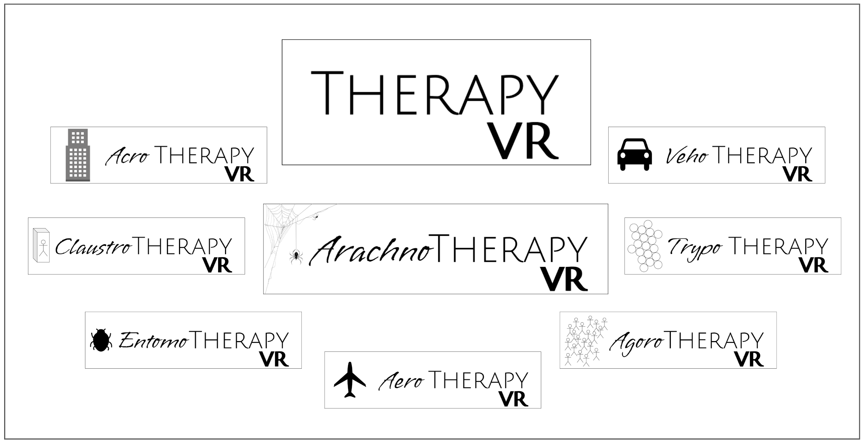
Future
Notes:
As for the Therapy VR expansion idea, here is a canvas of template logos for future installments. ArachnoTherapy VR, as you can see, is front and centre, and options for many other specific phobias are showcased as well.

Slide 34
Questions?
Notes:
Thank you very much for attending and listening to our presentation. We’re more than happy to field any questions you may have at this time.

